Slide 1
Music genre classification

Slide 2
ABOUT THE PROJECT
This project aims in exploring Dataset acquired from one of the MachineHack competition and use machine learning approaches to classify the dataset.

Slide 3



Data
17996
17
11

Slide 4




Problem
Notes:
Currently the data set which will be used for this project containing 11 classes of Music and the data is not distributed equally between them ,in addition to lack of information regarding the fields.

Slide 5



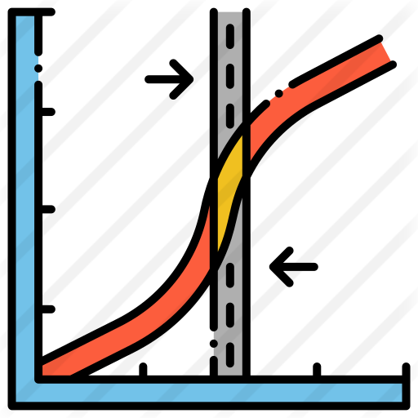
solution

Slide 6

Scores
0.7
0.5

Slide 7
$0,0
This is the total budget !!!!
But for sure it took time!!!

Slide 8

Project Timeline:
14/10/2021
Note: MVP.
21/10/2021
Note: Final submission.

Slide 9



Deliverables
Jupiter notebook which contains code of the project.
Final report

